Slide 1
CAPSTONE PROJECT
HOTEL BOOKING ANALYSIYS
Presented By:
Student Name : Rahamath Nisha M (81182114320)
College Name : Kurinji College of Engineering and Technology (8118)
Department : BE Mechanical Engineering
Year : 3rd Year 6th Sem

Slide 2
OUTLINE
Problem Statement
Proposed System/Solution
System Development Approach
Algorithm & Deployment
Result
Conclusion
Future Scope
References

Slide 3
PROBLEM STATEMENT
Have you ever wondered when the best time of year to book a hotel room is? Or the optimal length of stay in order to get the best daily rate? What if you wanted to predict whether or not a hotel was likely to receive a disproportionately high number of special requests? This hotel booking dataset can help you explore those questions!
This data set contains booking information for a city hotel and a resort hotel, and includes information such as when the booking was made, length of stay, the number of adults, children, and/or babies, and the number of available parking spaces, among other things. All personally identifying information has been removed from the data.
Explore and analyze the data to discover important factors that govern the bookings.

Slide 4
PROPOSED SOLUTION
* Utilizing advanced machine learning algorithms, our solution will analyse extensive historical hotel booking data to establish patterns and correlations.
*For optimal timing, a predictive model will consider factors such as seasonality, demand fluctuations, and promotional periods, providing users with insights on when to secure the most cot-effective room rates.
*The ideal length of stay will be determined through data-driven analysis, considering variables like day-of-week trends and duration-specific pricing strategies.
This holistic approach aims to empower travellers and hoteliers alike with actionable intelligence for strategic decision-making in the dynamic hospitality landscape.

Slide 5
SYSTEM APPROACH
System Requirements:
1.Hardware:
-A Computer with sufficient processing power, preferably with multiple cores or a
CPU for faster training of machine
learning models.
-Adequate RAM to handle the size of the dataset and computational requirements.
2.Software:
-An operating System compatible with the required machine learning libraries
3.Library Requirements:
Importing Below necessary Python libraries.
a)Pandas: A powerful library for data analysis.
b)Numpy: For Numerical calculations.
c)Matplotlip: To Create visualizations.
d)Seaborn: Another visualization library that works well with Matplotlib

Slide 6
ALGORITHM & DEPLOYMENT
ALGORITHM SELECTION
Data Exploration:
*Explore the hotel booking dataset structure, features, and target variables.
*Identify potential patterns, correlations, and outliers.
Problem Formulation:
*Define the Problem: Predict Optimal booking times, ideal length of stay,
and likelihood of special requests based on historical data.
Algorithm Selection:
*Regression tasks(e.g., predicting daily rates):
**Consider linear regression, decision trees, or ensemble methods
*Classification tasks (e.g., predicting special requests):
** Consider logistic regression, decision trees, or random forests.

Slide 7
ALGORITHM & DEPLOYMENT
DATA INPUT
Data Collection:
* Gather Historical hotel booking data, including information on booking dates,
length of stay, special requests, guest profiles, and relevant hotel details.
Data Cleaning:
* Handle missing values, outliers, and any inconsistencies in the dataset.
* Convert categorical variables into numerical representations through encoding techniques.
Feature Engineering:
*Create new features or modify existing ones based on domain language.
*Extract meaningful information from date variables, such as day-of-week or month.

Slide 8
ALGORITHM & DEPLOYMENT
TRAINING PROCESS
Data Splitting:
*Divide the dataset into training and testing sets to evaluate the model’s performance.
Feature Scalling:
*Standardize or normalize numerical features to ensure they have a consistent scale.
Model Training:
*Use the selected algorithm to train the model on the training dataset.
*Adjust hyperparameters to optimize model performance.
Model Evaluation:
*Evaluate the model on the testing dataset using appropriate metrics (e.g., Mean Squared
Error for regression, accuracy, precision, recall for classifications).
*Fine-tune the model if necessary.

Slide 9
ALGORITHM & DEPLOYMENT
PREDICTION PROCESS
New Data Input:
*Collect new data or use existing data to make predictions.
Pre-processing:
*Apply the same data pre-processing steps (cleaning, feature engineering, scaling) to the new data.
Model Inference:
*Use the trained model to make predictions in the context of the problem at hand.
*For regression, interpret the predicted values as optimal rates or length of stay. For Classification,
interpret predictions as the likelihood of special requests.

Slide 10
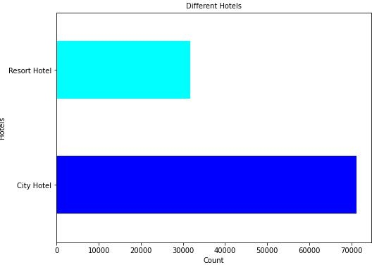
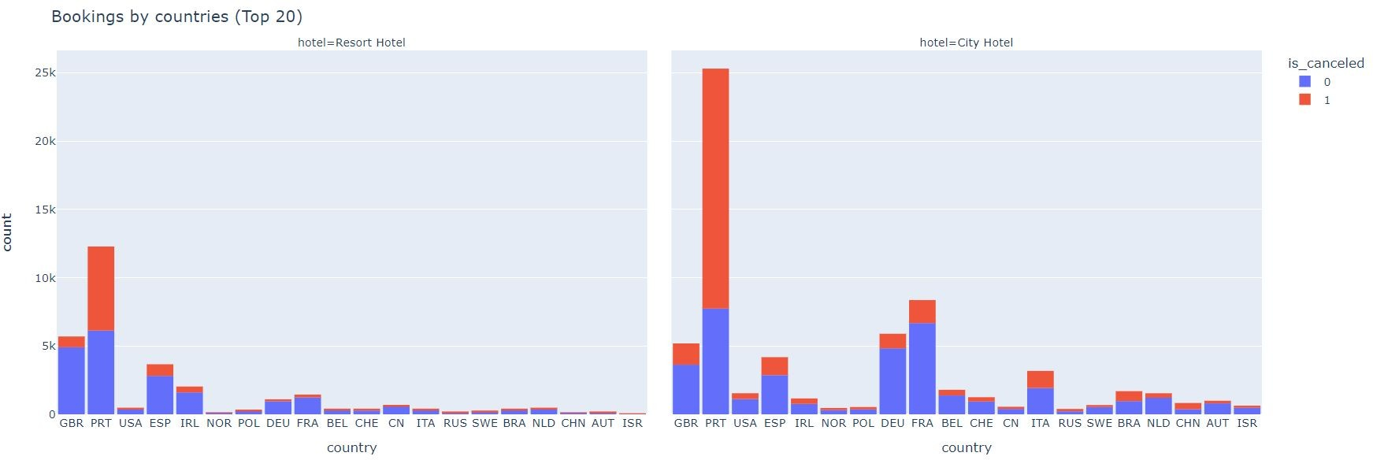
RESULT
Hotel Booking Preferences
Booking by Countries

Slide 11
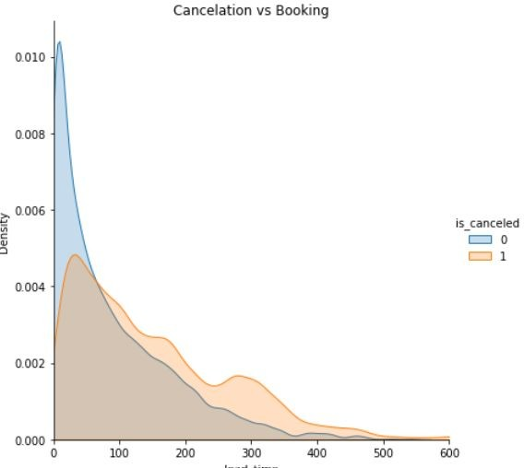
RESULT
Cancellation Factor vs Booking

Slide 12
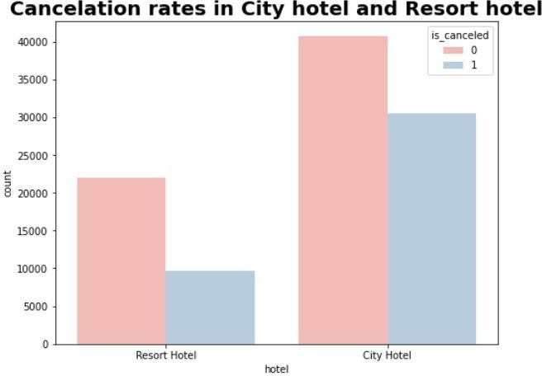
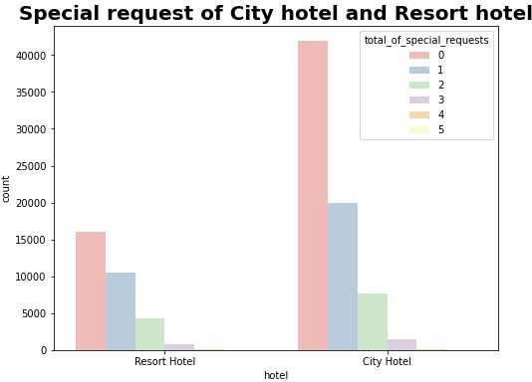
RESULT
Cancellation Rates
Special Request

Slide 13
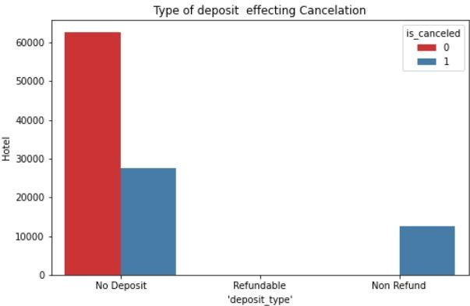
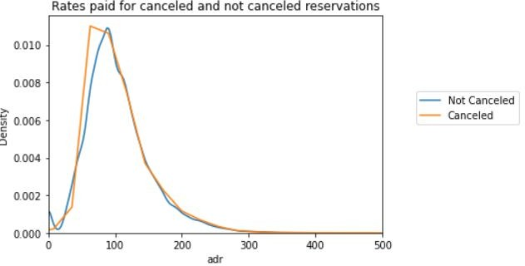
RESULT
Rates paid
Type of deposit effecting cancelation

Slide 14
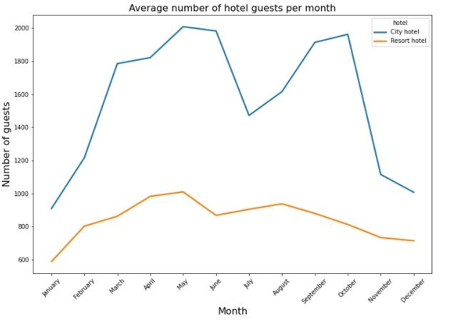
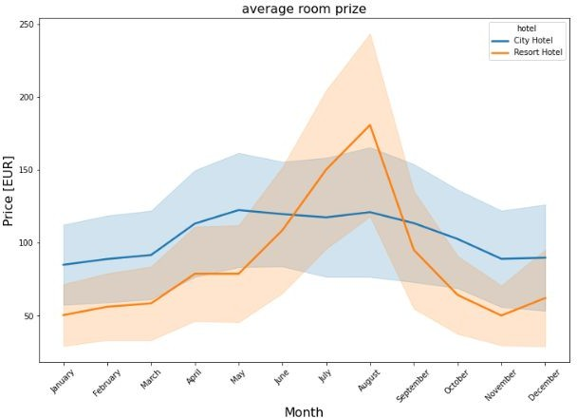
RESULT
Month wise booking trend
Monthly price variation

Slide 15
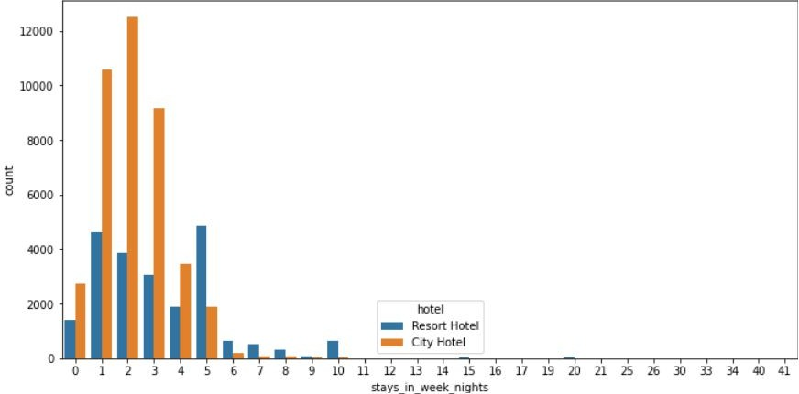
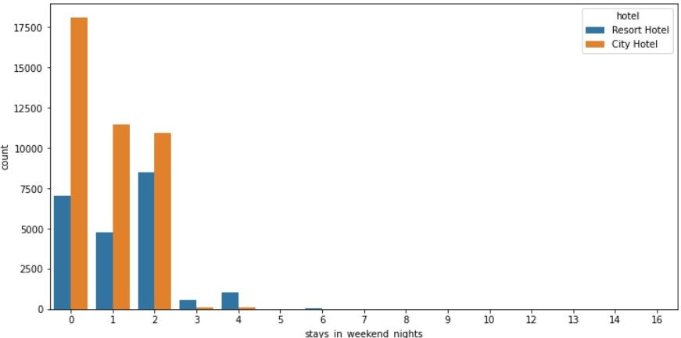
RESULT
Week end stay
Week day stay

Slide 16
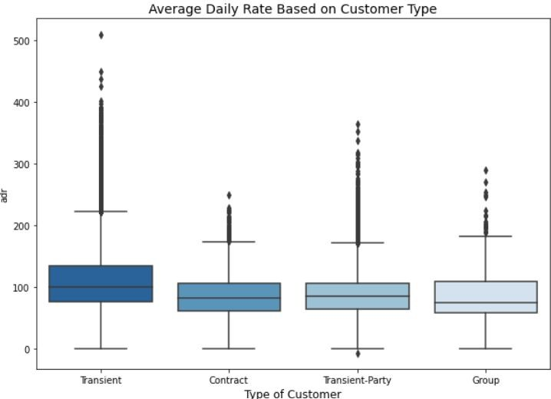
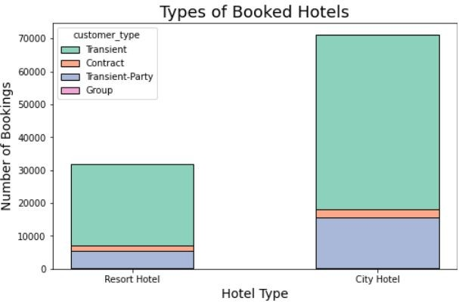
RESULT
Average Daily Rate
Types of Booked Hotels

Slide 17
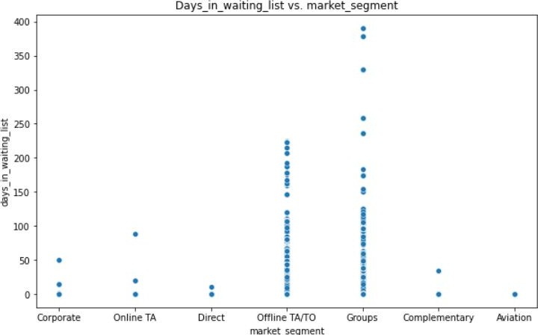
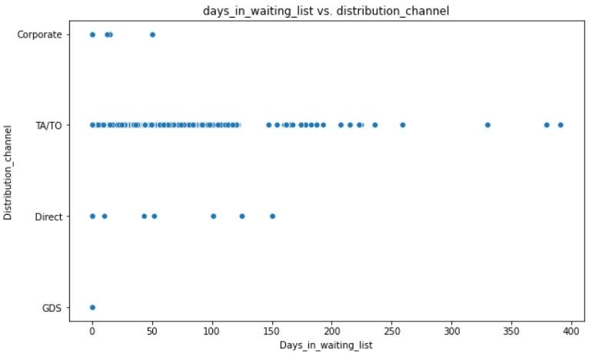
RESULT
Days in Waiting List

Slide 18
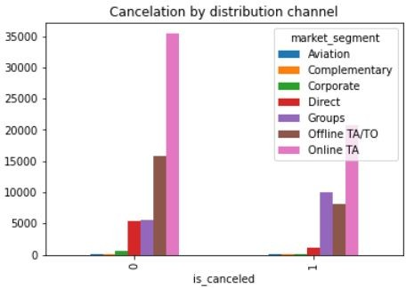
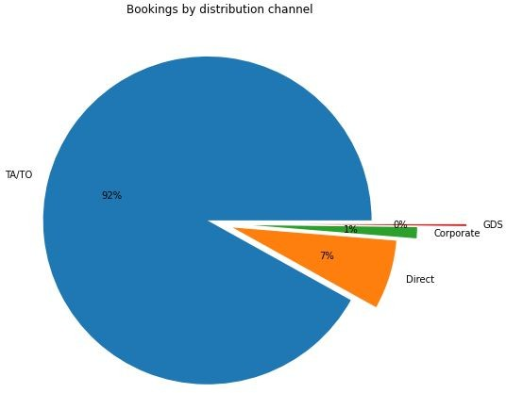
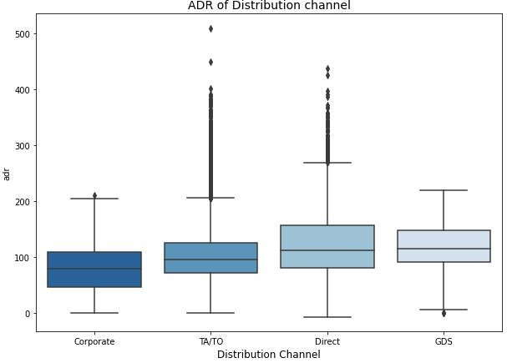
RESULT

Slide 19
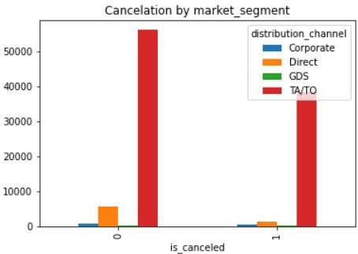
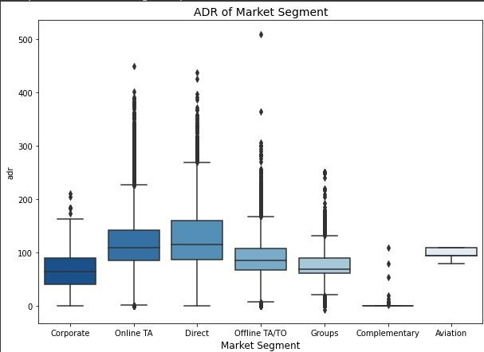
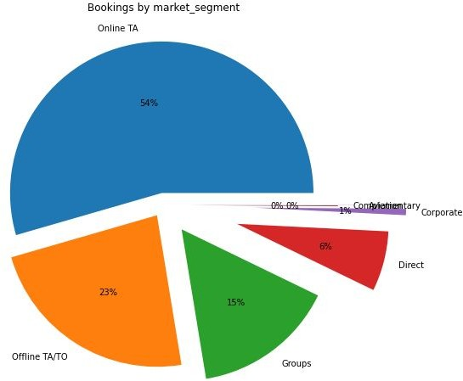
RESULT

Slide 20
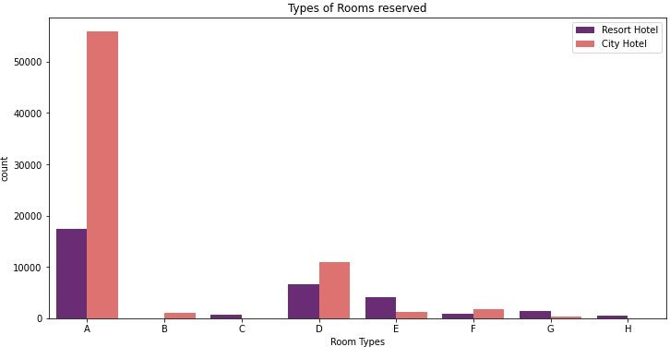
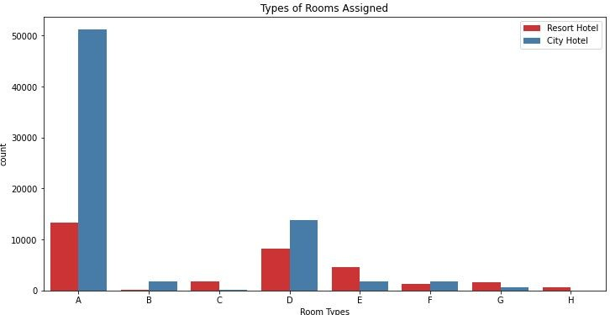
RESULT

Slide 21
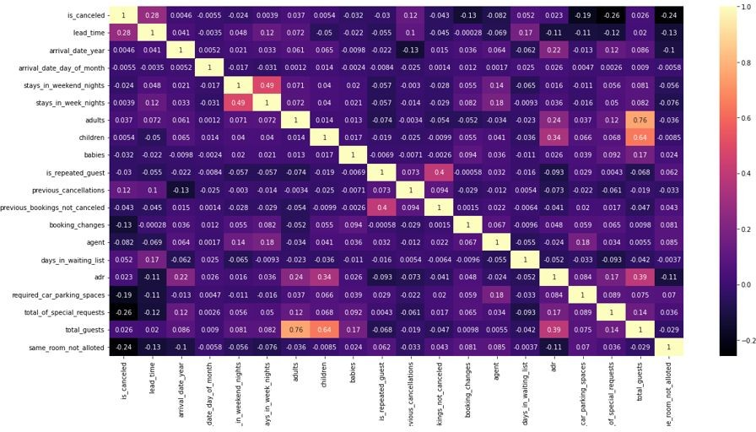
RESULT
Factors Influencing Booking
From the above map we found that few column like same room not allotted, no of special requests, car parking spaces, booking changes, negatively correlated like these column will not effect the bookings.
Whereas Lead-time and previous_cancelation,stay in weekend is highly correlated, which means that this columns effect my bookings .
If we dug deep we will see that adults and children are positively corelated with stay in weekend hence we can conclude that people staying in week end are mostly family.

Slide 22
CONCLUSION
1) The city hotel is the busiest as it has maximum booking. The avg is also high for city hotels making it more
profitable.
2) The City hotel has more guests during spring and autumn, when the prices are also highest, In July and August
there less visitors, although prices are lower. Thus, customers can get good deal on bookings in July and august in city hotel.
3) The number of guests for Resort Hotel go down slightly from June to September ,which is also when the prices
are highest. Thus, these months should be avoided for bookings. Broadly, May is the peak season for city hotel for bookings whereas for resort hotels March, April and May have the highest bookings.
4) Higher lead time has higher chance of cancellation. Also, history of previous cancellations increases chances of cancellation.
5) The prices in the resort hotel are higher during the summer and prices of city hotel varies but is most expensive during spring and autumn Both hotels few bookings have in Winter.
6) Transient customers ,direct customers are contributing maximum revenue to the hotel business.
7) No deposit cancellations are high compared to other categories, but these should not be discouraged per as booking in this category are also very high as compared to nonrefundable type bookings.
8) Cancellations are high when done through agents compared to direct bookings. Hotels need to do marketing and give special incentives for direct bookings as these may establish personal one to one relationships promoting customer loyalty

Slide 23
FUTURE SCOPE
The proposed solution lays the foundation for advancements in the real time of hotel reservation optimization.
Here are key areas for future exploration and enhancement.
Real-time Prediction:
Move towards real-time predictive models that account for instant changes in demand, external events, and other
dynamic factors to provide users with up-to-the-minute insights for booking decisions.
Personalization and Customization:
Enhance the predictive models to offer more personalized recommendations by considering individual
guest preferences,
loyalty history, and user-specific requirements, providing a tailored experience for each traveller

Slide 24
REFERENCES
https://pandas.pydata.org/pandas-docs/stable/user_guide/index.html
https://seaborn.pydata.org/
https://matplotlib.org/stable/contents.html
https://edunetfoundationorg-my.sharepoint.com/:x:/g/personal/shabaz_edunetfoundation_org/ETlWAP9Cb3xBrpRfrvtICDYBY_aZKVFTqMbbkOOK7R3V1Q?rtime=ES6L_Jli3Eg
https://github.com/Rahamathnisha1011/Hotel-booking-Analysis.git

Slide 25
THANK YOU

